Slide 1
Red Hat Marketplace

Slide 2
Objectives
After watching this video, you will be able to:
• Explain why using third-party software with
microservices is beneficial
• Describe how Red Hat Marketplace solves the
challenges of discovering, procuring, and
managing software

Slide 3
Benefits of OpenShift
• Enables simplified microservices development
and deployment
• Enables use of third-party software to fill
gaps without requiring development of an entire
solution

Slide 4
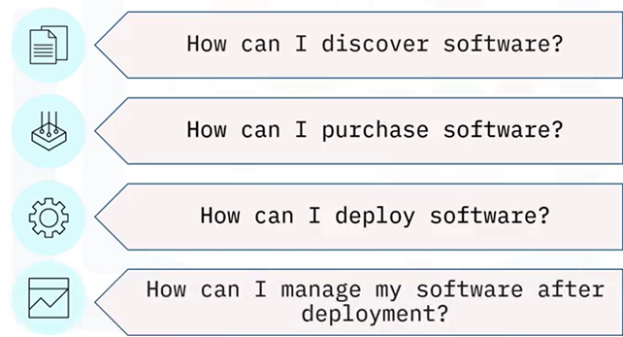
Planning your software purchase

Slide 5

Discover software
Red Hat Marketplace is a one-stop
shop for certified OpenShift-ready
software
• Search for available products and
filter results
• View product descriptions and
automation capabilities

Slide 6

Buy software
• Size software
• Sign up for free trials
• Use convenient software purchase
options including:
• Real-time pricing
• Billing options
• Subscription choices

Slide 7

Deploy software
Deploy from Red Hat Marketplace
to selected OpenShift clusters on
any cloud or on-prem environment

Slide 8

Manage software
Use Red Hat Marketplace to:
• Perform lifecycle tasks such as
upgrades and insights
• Access continuous support for
purchased products

Slide 9
Summary
In this video, you learned that:
• Certified software fills gaps in your
application, and improves IT efficiences,
allieviating your organization's need to spend
time and money developing new microservices

